Slide 1
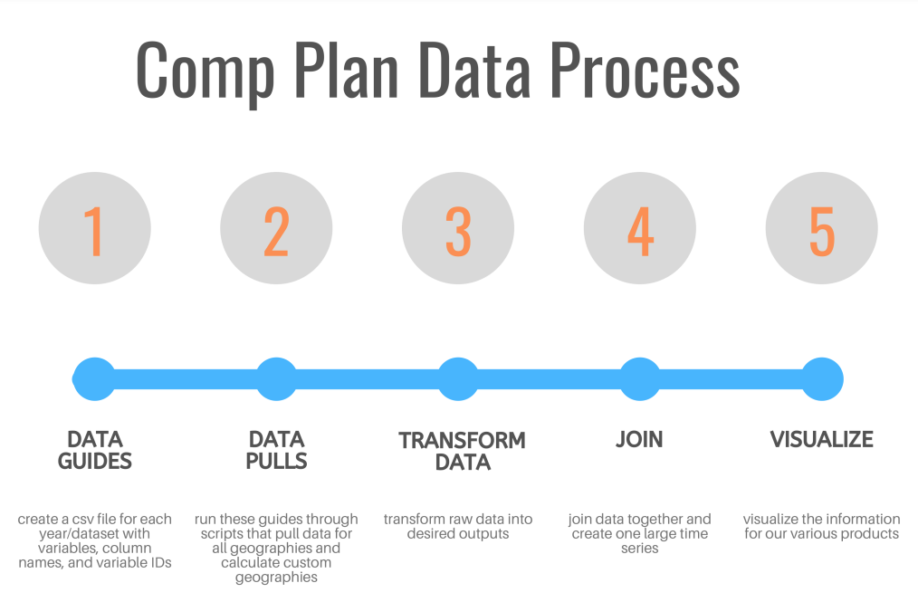
Notes:
This is an overview of the entire project flow – right now this is just the Census Bureau data, but that’s about 80% of the data going into the comp plans. The information from BEA, BLS, and third party sources can be added in where appropriate.
The first step is searching through the Census data series’ variable lists and creating a csv file with all of the information required to pull the required variables and name each of them as a column in a dataframe that we are creating.
The second step is to import these lists, called data guides, into a platform for writing Python and other coding languages called jupyter notebooks. There is a notebook file for each data series and year – two from all three years that we are pulling data for and one for a single variable from the subject tables.
These notebook files contain code to interface with the Census API and pull the listed variables for all required geographies at once.
This data is exported, and then run through another set of notebook files to transform the raw data into the datapoints we use for our project. This is then joined as a time series and formatted in a couple different ways to feed into the visualization files.
At this point, it’s taken me a few months to create this process, but running it all from the beginning takes under 8 minutes and it’s not only highly adaptable code that will continue to get more efficient as my code improves, but also creates a base for other smaller data requests that will be completed using the same process. I wanted to take us all through the process in a bit more detail now, to inform our discussion about how we visualize this information.

Slide 2
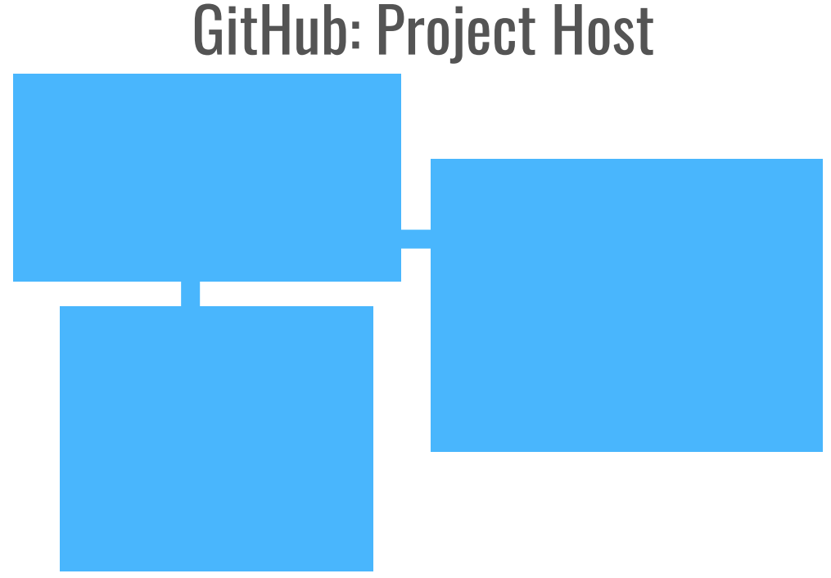
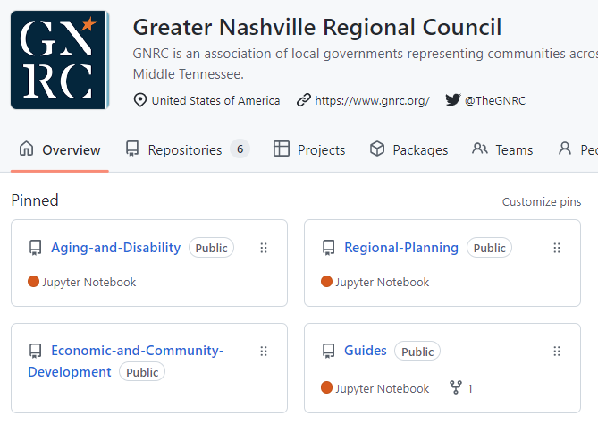
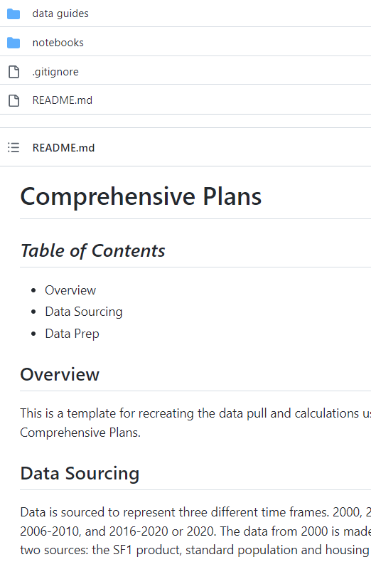
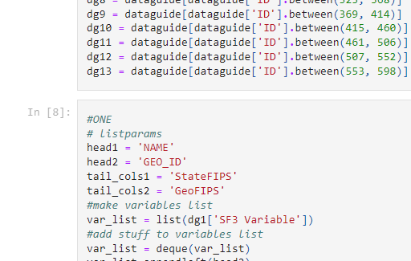
Notes:
I’ll start from the end – there are really two classes of products as I see it – the visualizations and analysis from our team, and the documentation of our project. We’re here to focus on visualizations, so I wanted to just introduce you to the project documentation in GitHub.
This is a very standard platform for individuals and organizations to host their projects – it serves as a resource to your own team, and as a sort of portfolio. There are easy ways to collaborate on projects and to maintain version control – it also saves your work in the case of file loss.
Here’s what our front page looks like, then I’ve included a snapshot of what the “readme” page looks like so far for this project, and finally I’ve included a snapshot of what some of this code would look like to someone clicking through our profile.
The categories are called repositories – you can make them public or private, you can make the readme fairly elaborate by including images, links, etc.
Basically it allows us to catalog the beginning stages of a project in a way that is simply not possible with data downloads. Another angle to the benefit of using this platform is that the entire project is available for download to Ashleigh, for example, with a few clicks, and with the proper software installed she could run and adapt all of this code herself.
Eventually, another staff member could write a similar process for say, BEA or Nashville public portal data and we could easily merge it all together.
Also, an outsider or a member of the planning team could look at the readme and quickly understand the overall process for the project, and see that they could click on the data guides folder and find the sources for the raw data laid out very clearly.. Not only do most analyst, data scientists, and developers have an account, but also many of our peers like CMAP, Delaware Valley Regional Planning Commission, ARC, etc.

Slide 3
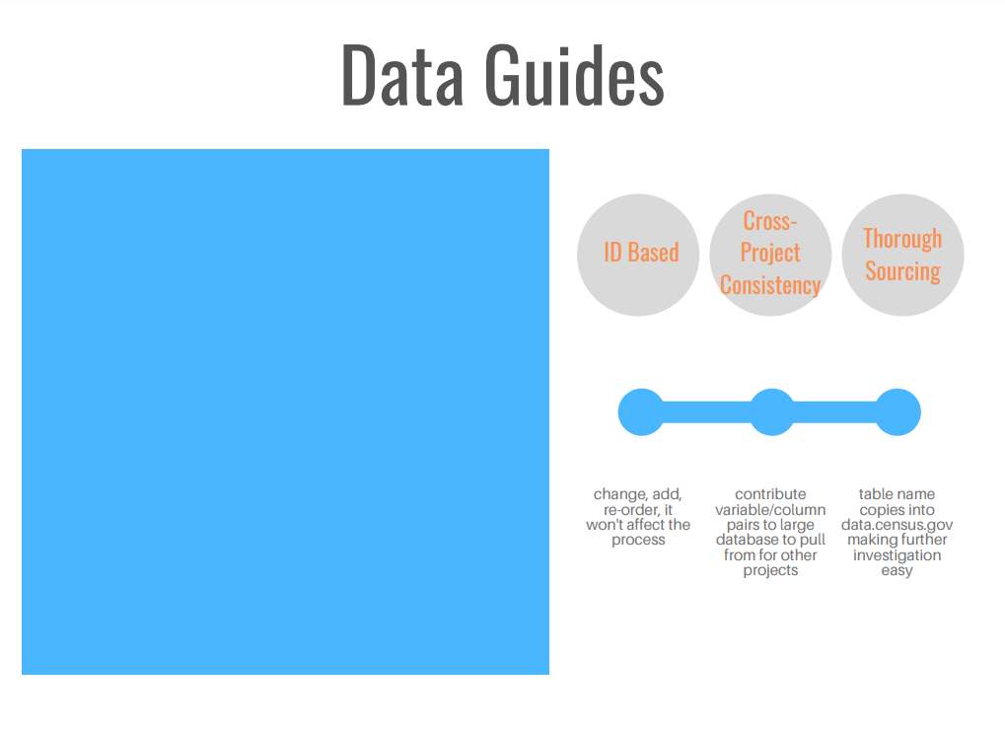
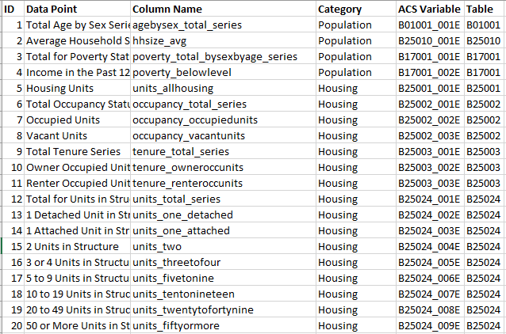
Notes:
Now, for each of the steps outlined in the first slide - I wanted to go into a bit more detail to highlight some of the benefits to this process, starting with the data guides.
There are three important things here –
First - you can see that the ids are simply numbers – I’ve pointed out that this system allows you to change the data included, add more, reorder, and you just re-run the ID numbers and it won’t affect the rest of the process.
Second – over time all of these variables and column names are added into one large file for each dataset. There is already a large base for expediting new, smaller projects.
Finally, not only does this document our source from the very beginning but also planning staff or whoever else could simply copy paste the table code into data.census.gov to further examine anything they wanted to.

Slide 4
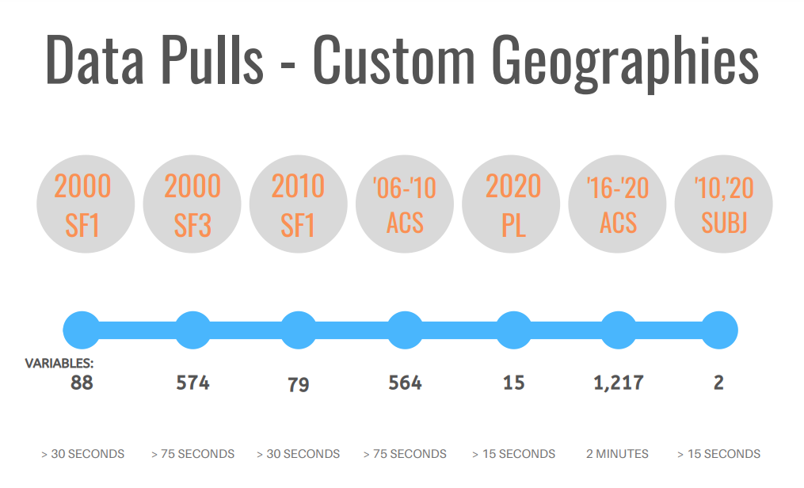
Notes:
This outlines the separate API call files –
these take you through importing and formatting each data guide so that you can run the list of variables and column names through the API call for the nation, state of Tennessee, all counties in our regions, and all incorporated places in our region
Next is creating custom regions and calculating incorporated versus unincorporated areas for counties without incorporated places that cross county lines.
This can all be done in approximately 6 minutes. That’s 2,539 variables pulled for 68 different geographies, or 172,652 cells of data pulled.

Slide 5
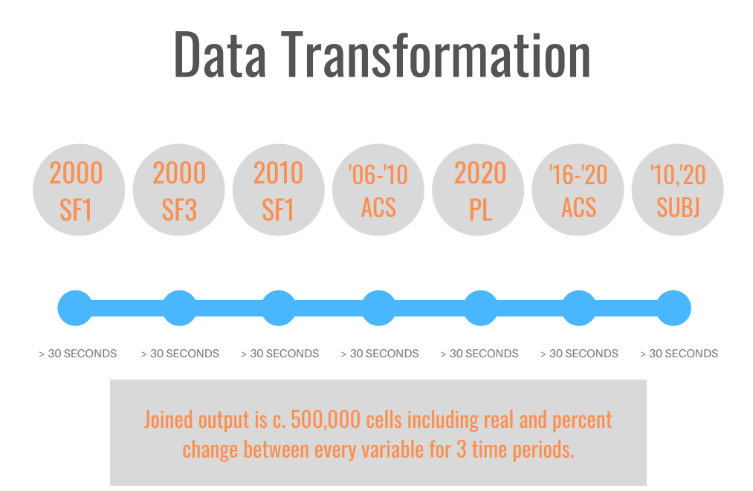
Notes:
Taking the raw data and transforming it to the final datapoints, joining all years, and formatting to whatever specifications you have takes less than 2 minutes. These transformations include taking the raw data and aggregating to something like an age group, then calculating each new variables percent of the whole where relevant. Calculations are made based on functions, not fully written code, so we could do something like multiply ever calculated percentage by 100 to look nice in a table virtually immediately. When the data is joined and a time series is created, we find real and percent change between all years for all relevant variables. The output is around 500,000 cells.

Slide 6
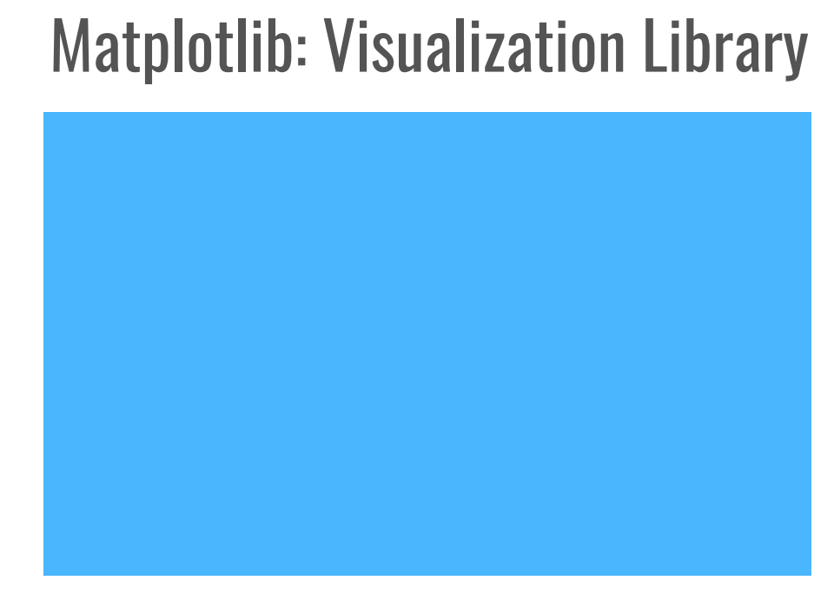

Notes:
Finally, the method I’ve started to build out for visualizing the data to go in to the internal technical documents, and ultimately other iterations of the comp plan will use similarly adaptable code
We will be able to only slightly change the documents between geographies and years to get our final product.
Matplotlib is a data visualization and graphical plotting library for Python. It is highly customizable and widely used, and the graphics can be exported as vector files.
The rest of our time is for setting figure standards and discussing the different types of plots that can be made this way. Setting these standards means that we can quickly reproduce this first round of figures, it doesn’t mean that we’re boxed in and can’t create more, or adapt these, but it does mean that we have a consistent starting place –
if we jump off from the end of the process as it is right now and continue to work in Python there is next to no room for human error to creep in between steps, or for any confusion about what steps were taken at any point. All of the benefits I discussed over the last few slides - consistency, transparency, manipulability, etc. will apply to the visualization step as well. That’s my endorsement for using this method, and
Next I’ll show the sorts of figures available – followed by some samples that I’ve made so that we can discuss our own standards and what can and can’t be changed using this platform

Slide 7
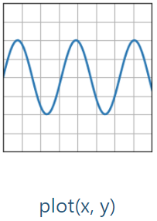
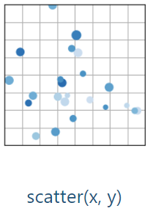
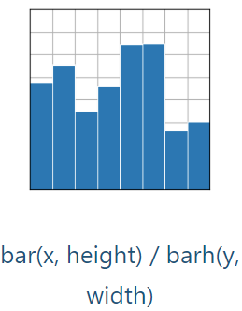
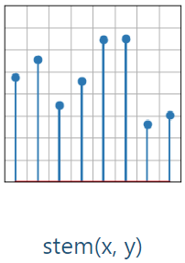
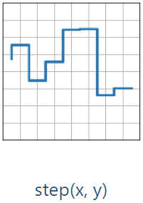
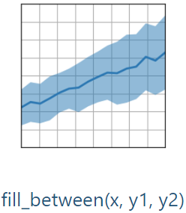
Notes:
This is an outline of the basic x y graphs available

Slide 8
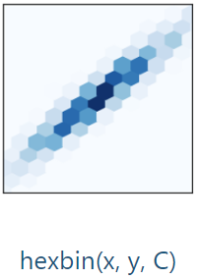
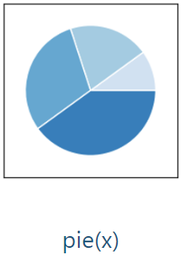
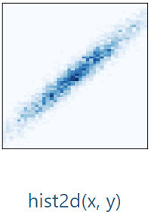
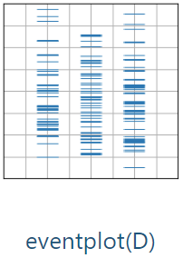
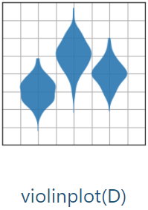
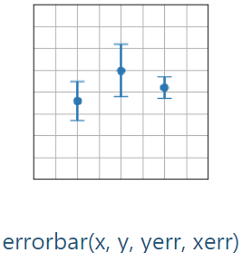
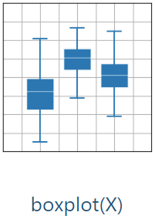
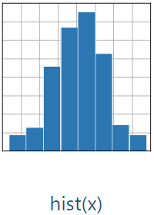
Notes:
This is an outline of the statistical plots available

Slide 9
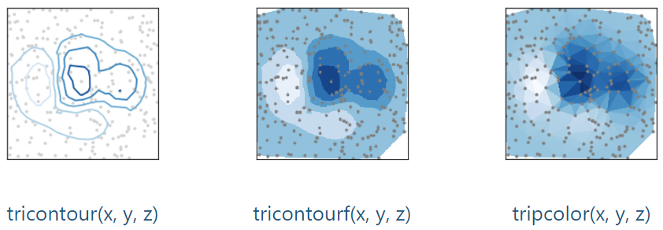
Notes:
There are also options for multidimensional data visualizations

Slide 10
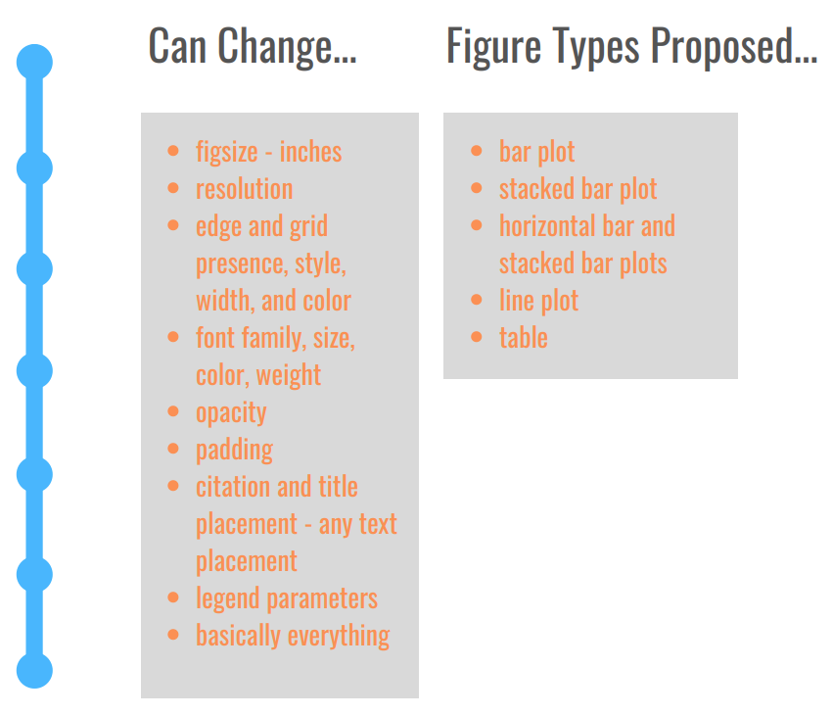
Notes:
The process I’ve built out so far begins with as many style parameters as possible getting hardcoded at the beginning of each document.
This includes standard things like font families, weights, and various color codes. It also includes code to format axes appearance and labels based on the datatype (year, percent, etc.), autofill text for citations, and setting the figure size for optimal use in a Word document or other product.
Data-prep wise, a temporary data-frame is created for each plot or table filtered for geography, year/ time frame, and relevant datapoints
Then a figure is created from this temporary dataframe without ever altering the source data
Eventually when we’re duplicating this step for different plans we’ll just be making small tweaks like axes tolerance and title position

Slide 11
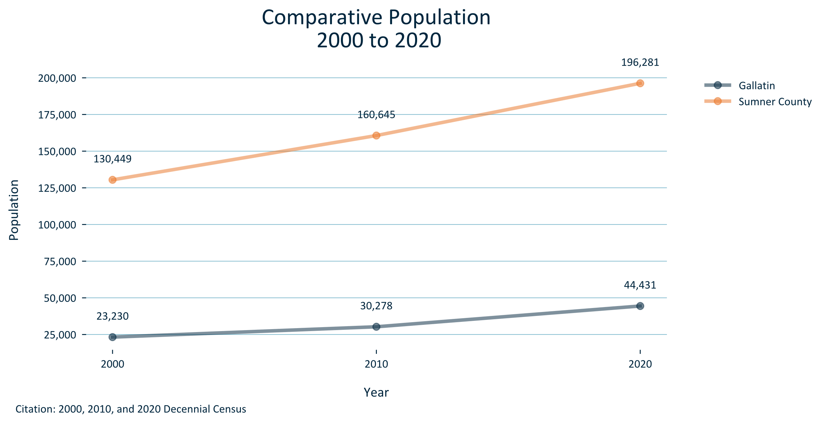
Notes:
Now we’ll move into some samples – I’ll just flip through some different options and then we can start to nail down parameters

Slide 12
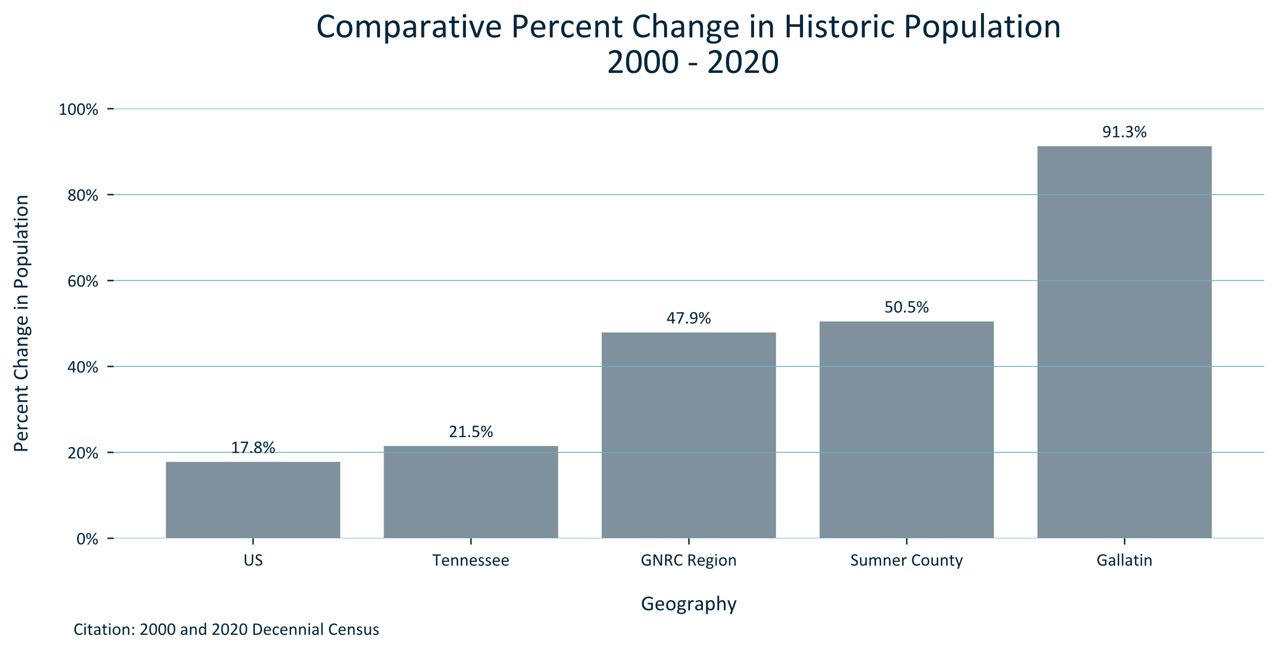

Slide 13
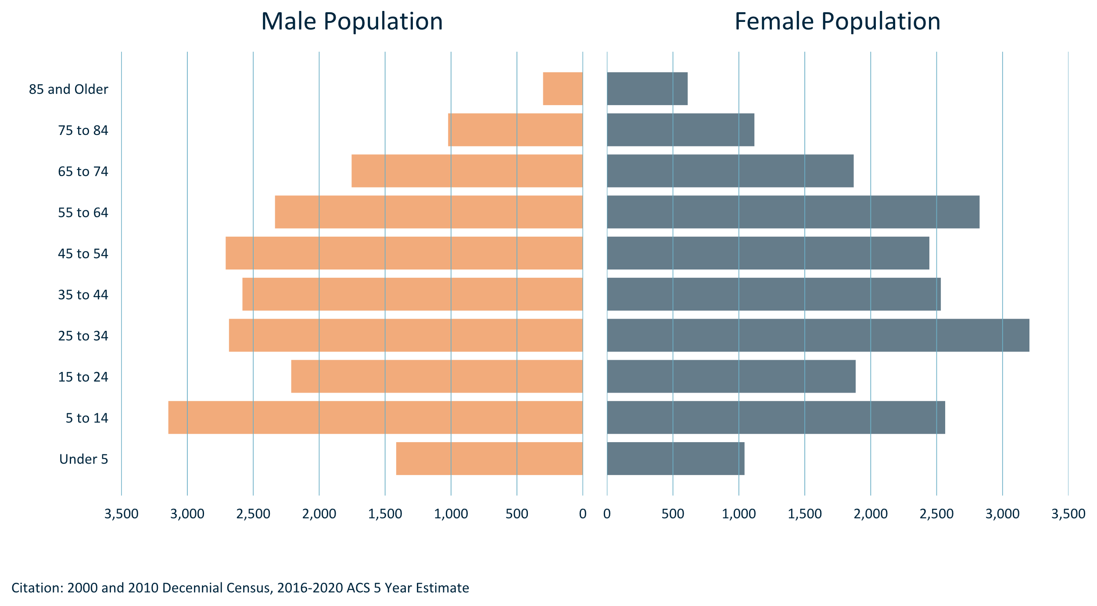

Slide 14
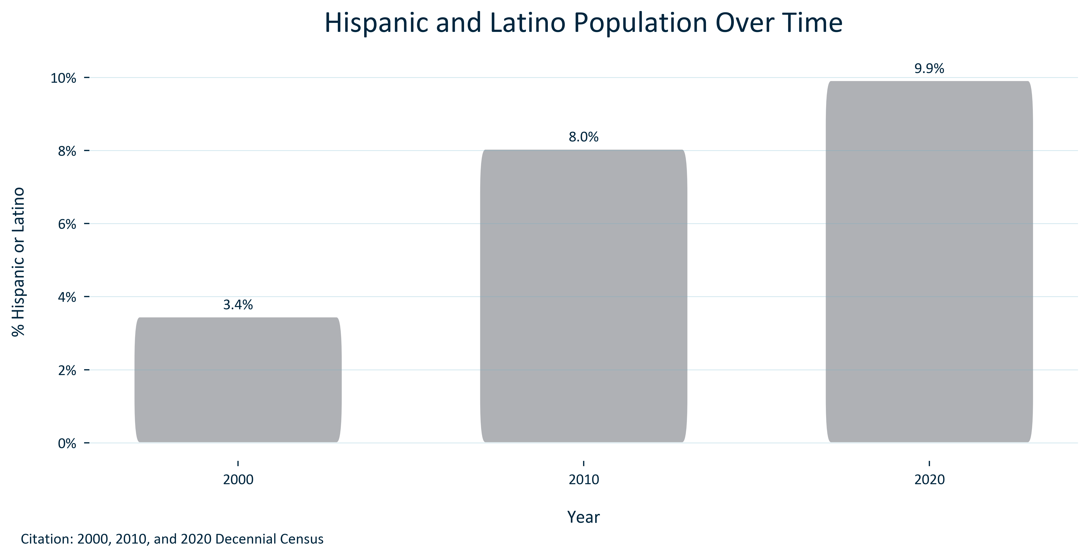
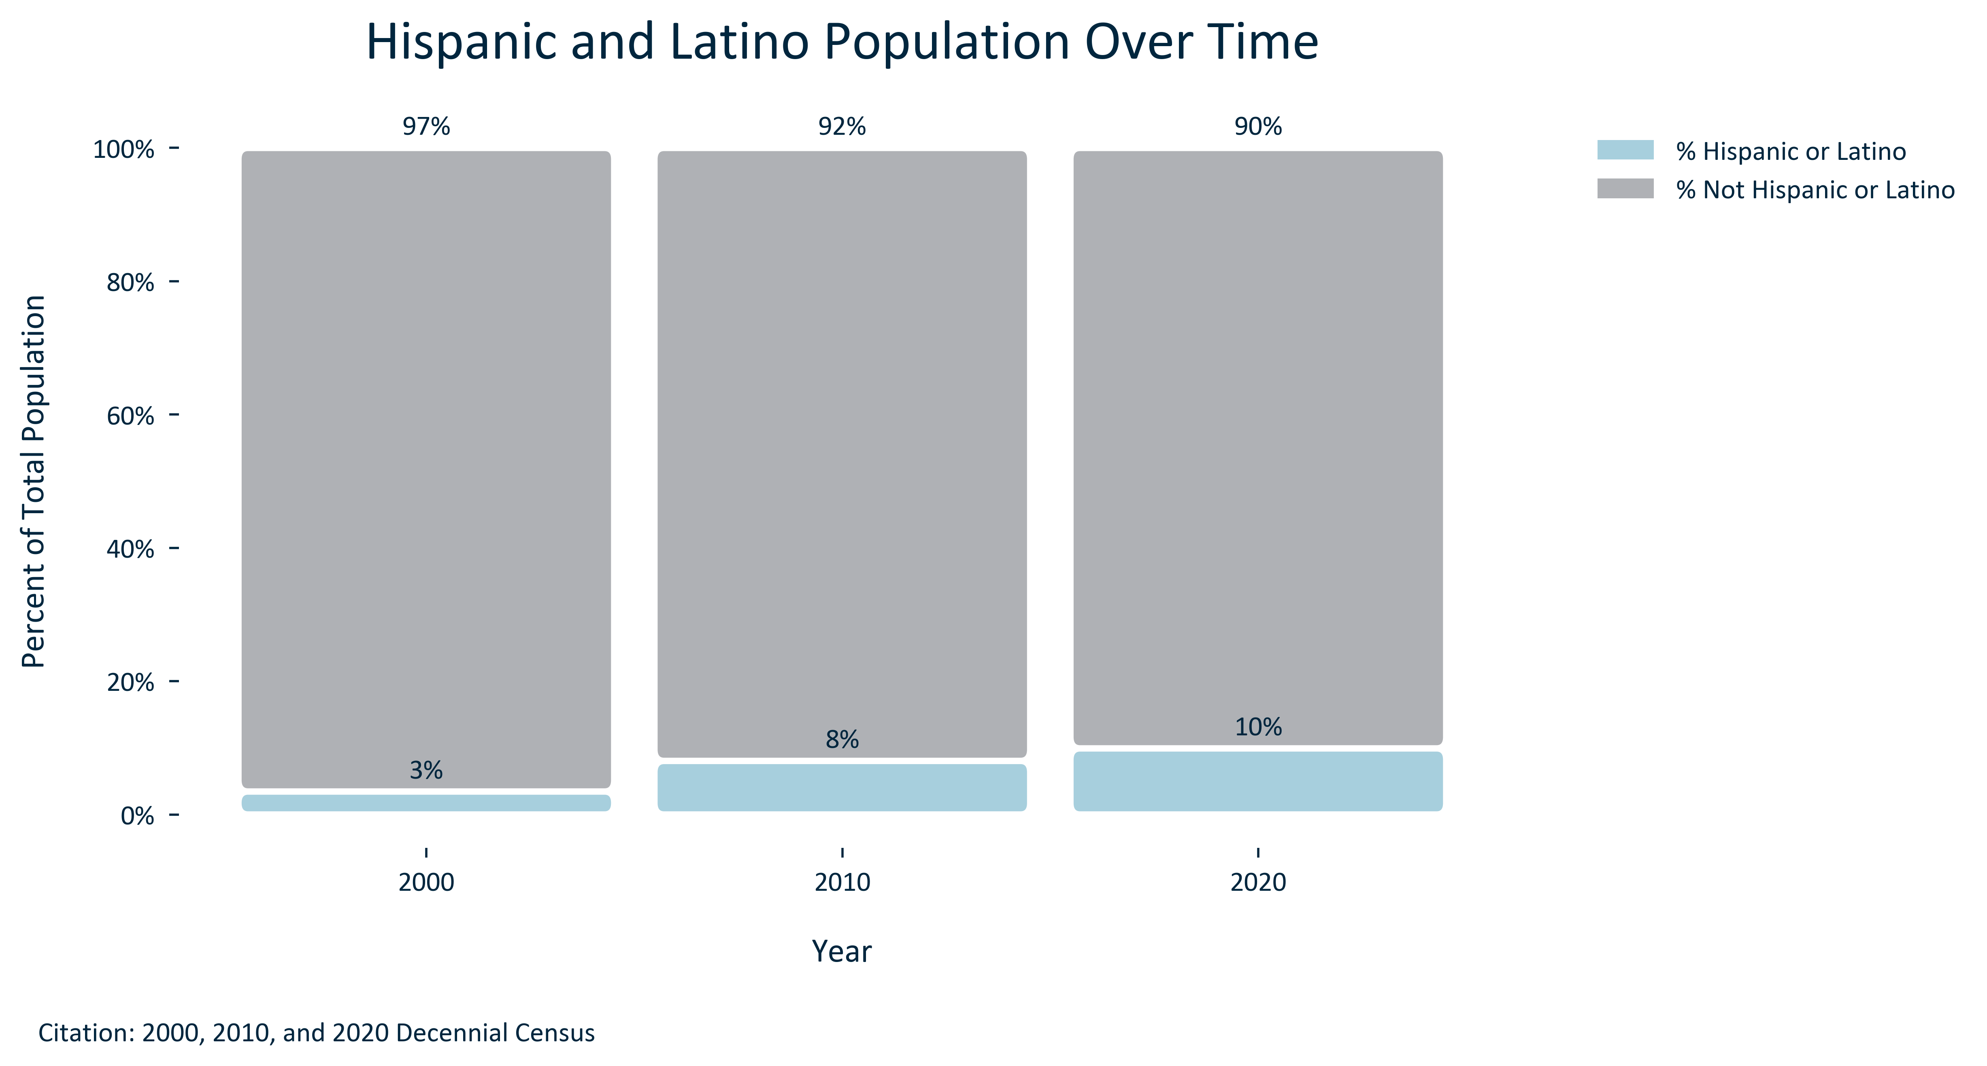
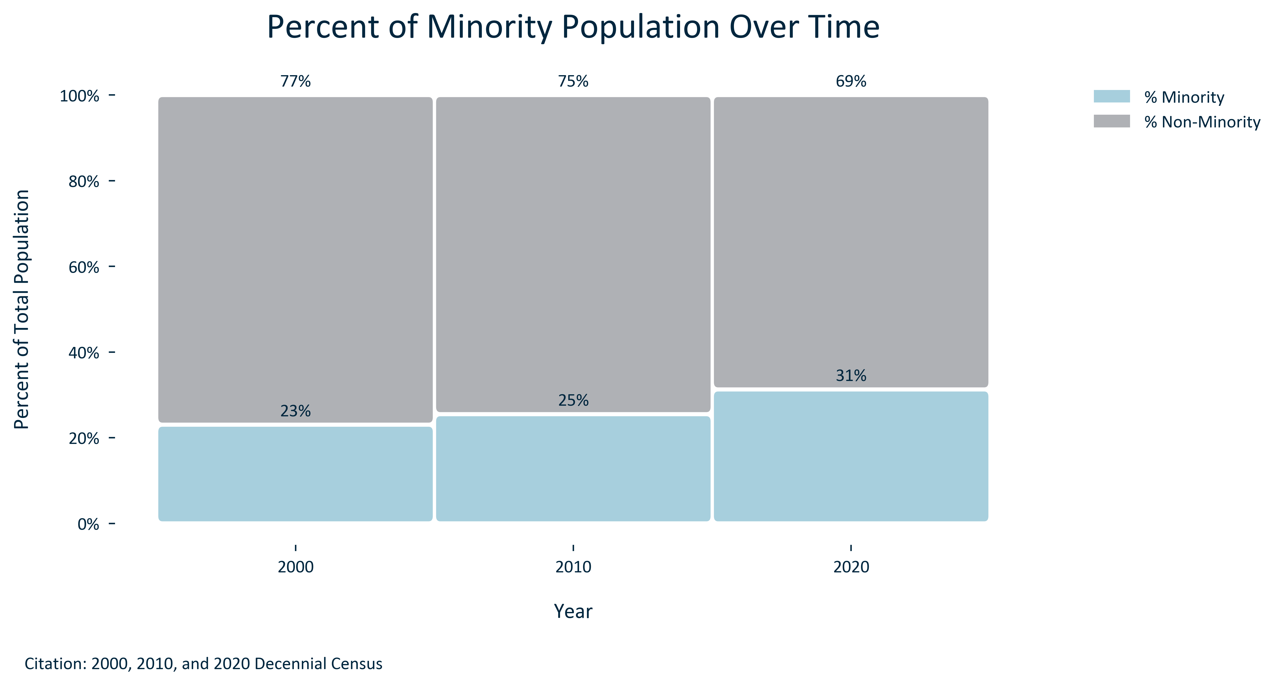

Slide 15
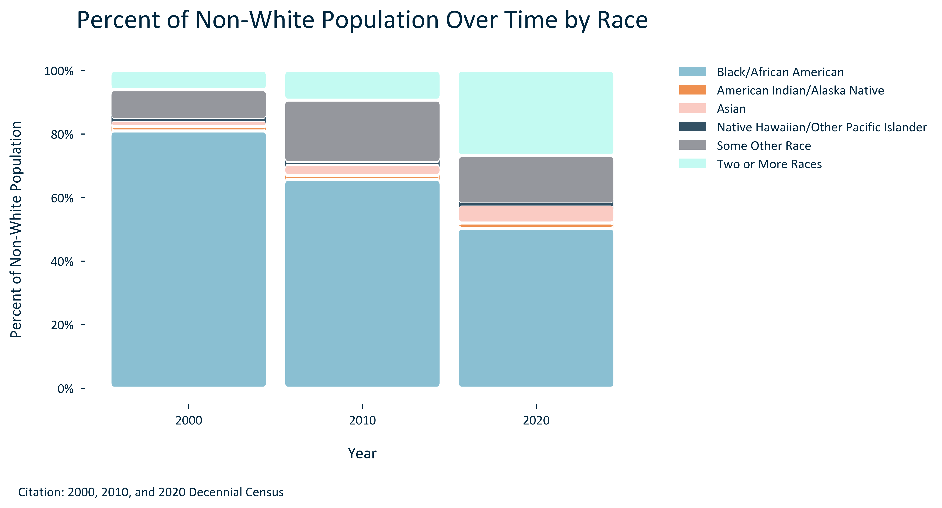

Slide 16
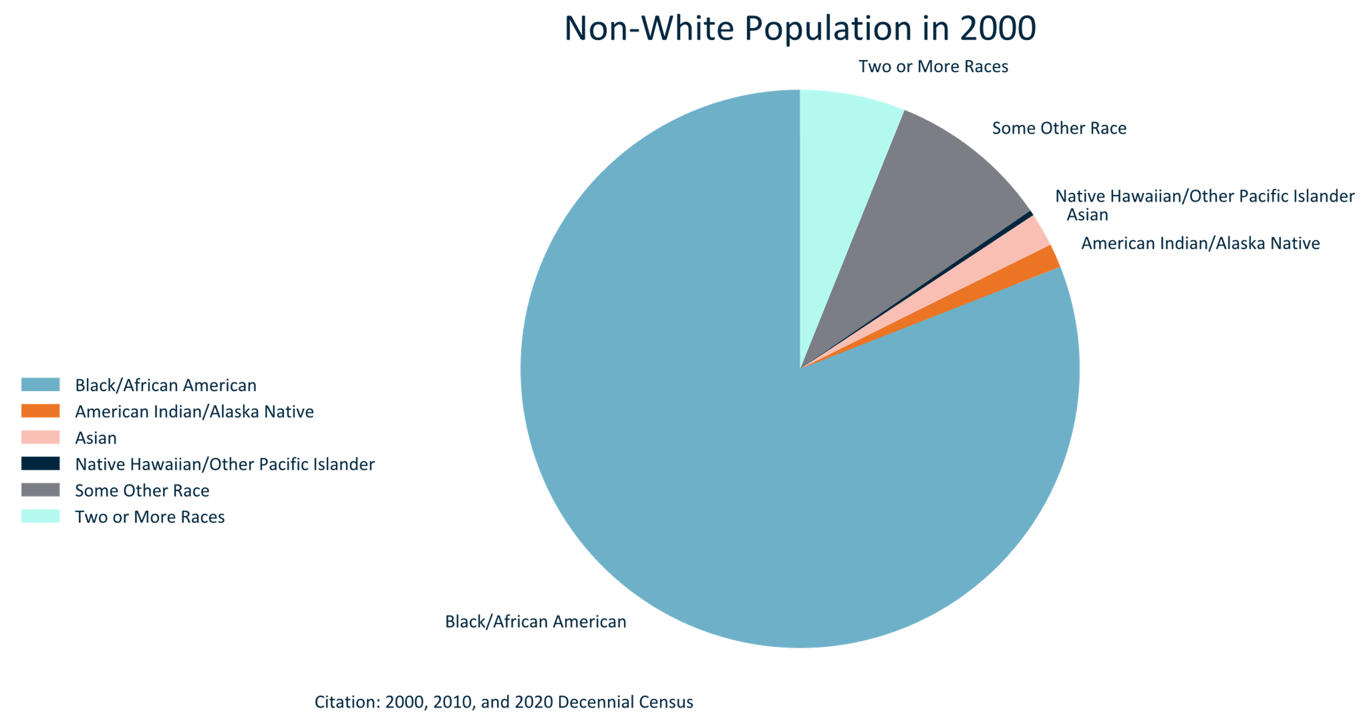

Slide 17
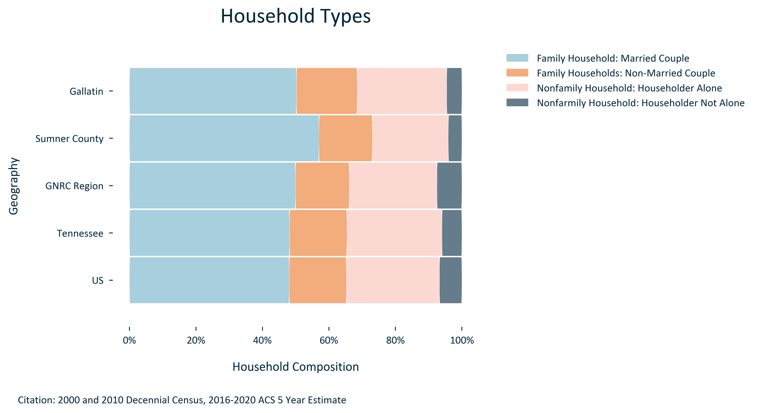

Slide 18
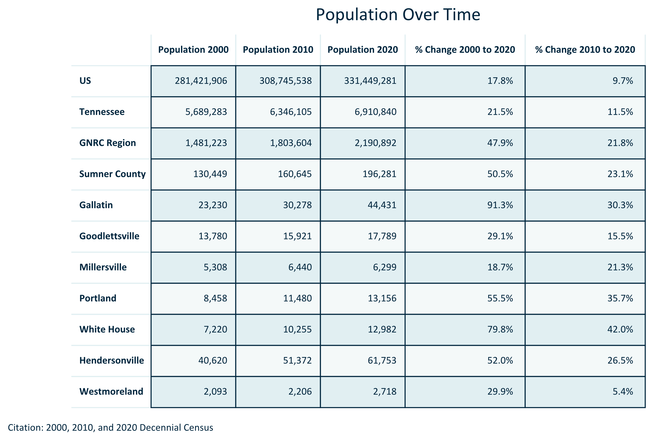
Notes:
You can set a parameter for column width or set it to be as wide as need be for each column. You can also decide if you want the headers to split to two lines or not

Slide 19
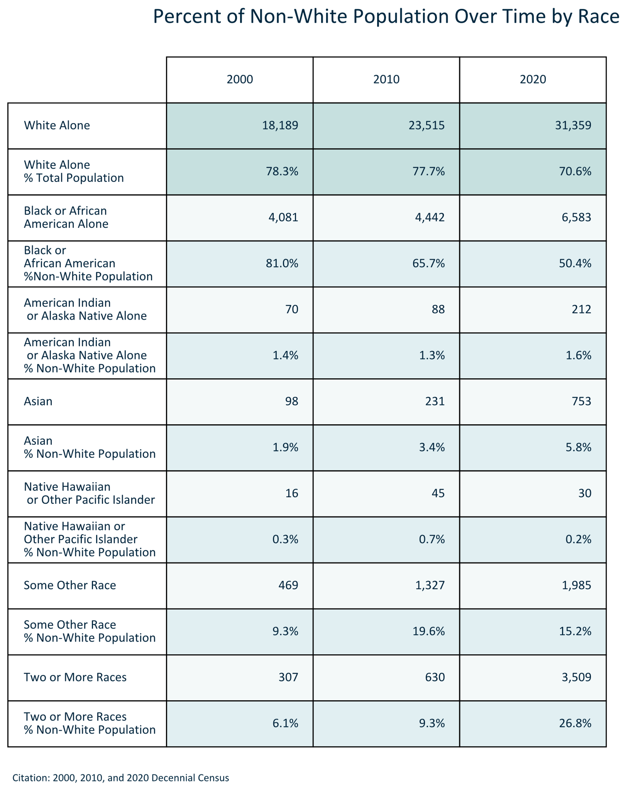

Slide 20
